Slide 1
STOCK MARKET PERFORMANCE
Prepared by :- ABHINAV KAKKERI

Slide 2
INTRODUCTION
This dashboard is designed to provide detailed insights into financial data, market trends, and trading volumes.
Analyzing key metrics such as price fluctuations, volatility, and transaction patterns, it helps users make informed decisions.

Slide 3
AKNOWLEDGMENT
This dashboard visualization presents a variety of insightful data representations, including matrix charts, line graphs, scatter plots, and bar charts.
It effectively communicates trends in volume, price, and standard deviation, offering a comprehensive overview of the dataset.
If you're looking for ways to enhance its readability or add more context, consider adding annotations or tooltips to key areas

Slide 4
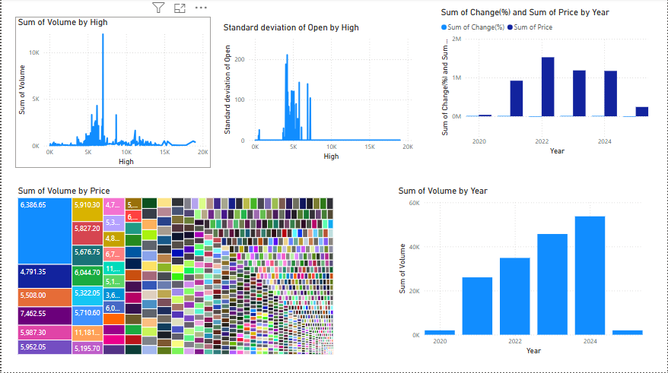
DASHBOARD VISUALIZTIONS

Slide 5
KEY SECTIONS
Sum of Volume by Price:- A heatmap-style representation showing the relationship between different price points and corresponding transaction volumes.
Sum of Volume by High:- A line graph illustrating how the sum of volume correlates with the highest recorded price values.
Standard Deviation of Open by High:- A bar graph analyzing the volatility by comparing standard deviations of the opening price against high price trends.

Slide 6
Key sections
Sum of Volume by Year:- A time-series bar graph depicting total volume traded across different years, aiding in identifying historical trends.
Sum of Changes & Sum of Price by Year:- Two comparative bar graphs showcasing annual changes in value and total price fluctuations over the years.

Slide 7
Interpretation & Insights
Market Trends:- By observing volume distribution across price ranges and years, one can infer trading activity intensity at various price points.
Volatility Analysis:- The standard deviation metrics reveal the fluctuation levels in opening prices, helping traders assess risk factors.
Historical Patterns:- Yearly volume and price trends offer valuable hindsight into market dynamics, making it easier to predict future movements.

Slide 8
CONCLUSION
The dashboard serves as a useful tool for financial analysis, providing traders and analysts with structured data insights.
Future enhancements could include interactive filtering options and correlation matrices for deeper analytical comparisons

Slide 9
THANK YOU

